Slide 1

IOT Smart Parking System
Submitted To:
Sovon Chakraborty
Lecturer Department of CSE
European University of bangladesh
Submitted By:
Team Ultra Version
BSC in CSE
European University of bangladesh

Slide 2






Team Ultra Version Members
Shahbaj Rahman
ID : 200122087
BSC in CSE
Esrat Jahan
ID : 200122144
BSC in CSE
MD: Moniruzzaman
ID : 200122090
BSC in CSE
A.K.M Saharuzzaman
ID : 200122106
BSC in CSE
MD: Miraz Mridha
ID : 200122146
BSC in CSE
MD. Shohidul Islam
ID : 200122111
BSC in CSE

Slide 3
Introduction
IOT
Parking System
The internet of things
or IOT, is a system of interrelated
computing devices, mechanical and
digital machines
A car parking system is a mechanical device that multiplies parking capacity inside a parking lot. Parking systems are generally powered by electric motors or hydraulic pumps that move vehicles into a storage position

Slide 4
What is IOT Smart Parking System?
An IOT based smart parking system, also known as a connected parking system, is a centralized management system that allows drivers to use a smartphone app to search for and reserve a parking spot.

Slide 5
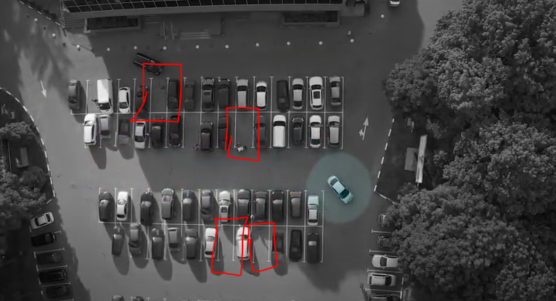
What is the Problem?

Slide 6
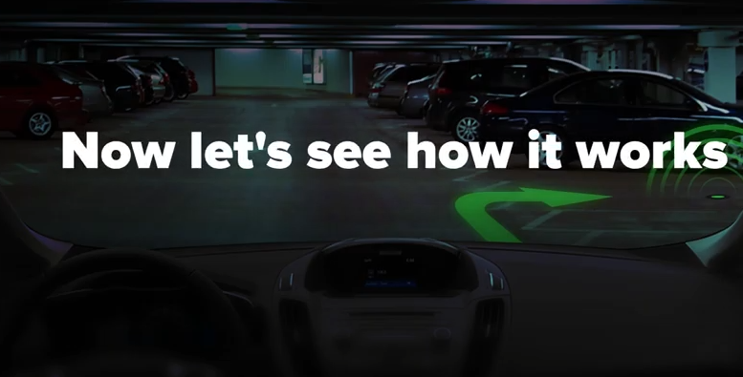

Slide 7

How to work this IOT smart Parking System ?
Here is 3 concept of this system
Space Detector
Data Transfer
Data Receiver from smart device

Slide 8
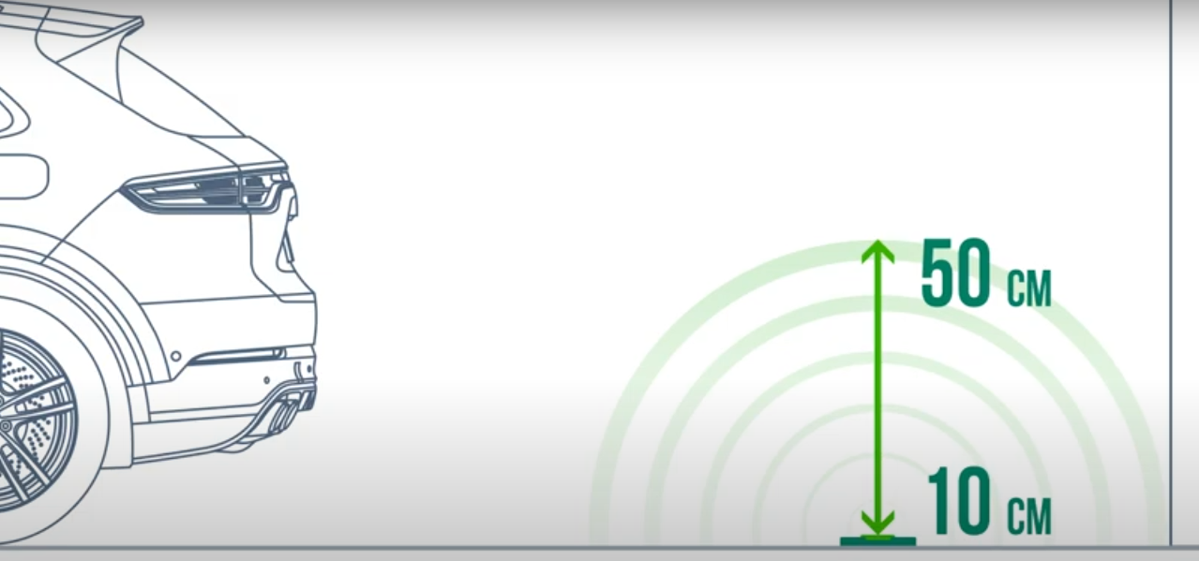
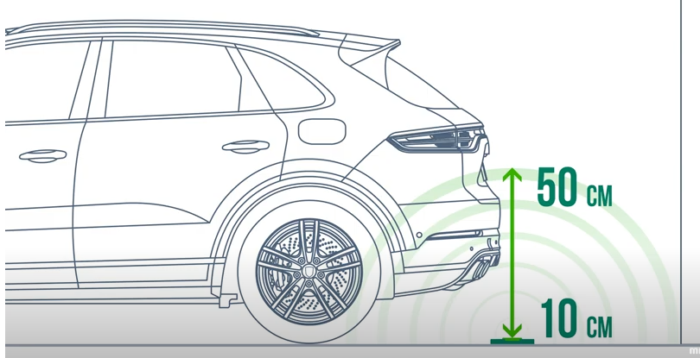

How to work this IOT smart Parking System ?
FREE Space
Space Detector
No Space Free
Dirty Space Free

Slide 9
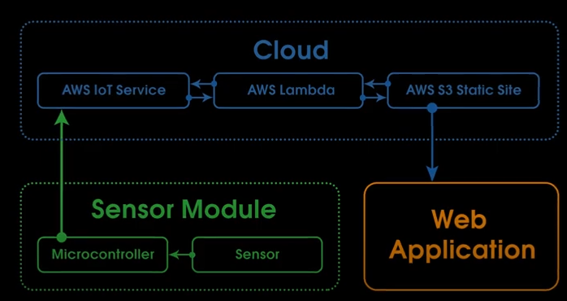
How to work this IOT smart Parking System ?
Data Transfer

Slide 10
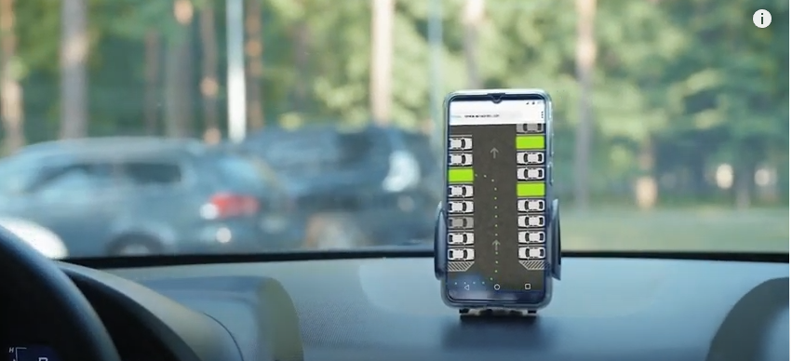
How to work this IOT smart Parking System ?
Data Receiver from smart device

Slide 11

THANK YOU ALL

